Slide 1


How to Get Good Beer Review Scores: A Short Machine Learning Project

Slide 2
OVERVIEW
Part 1 – Business Context
The Evolution of the Market
Some Recent Figures
The Research Question
Part 2 – Data & Models
An International Dataset from an online community
Linear Regression
Random Forest
Part 3 – Deployment & Business Impacts
Recommendations: Improving Breweries Decision-Making by Prioritizing the Right Elements
Limitations
Future Directions:
Providing Customer Services Through Recommender Systems
Refining Our Understanding Through Customer Segmentation

Slide 3

Part 1 – Business Context
What is the beer market about?
Who are its consumers?
How is the beer market evolved and is expected to develop?

Slide 4
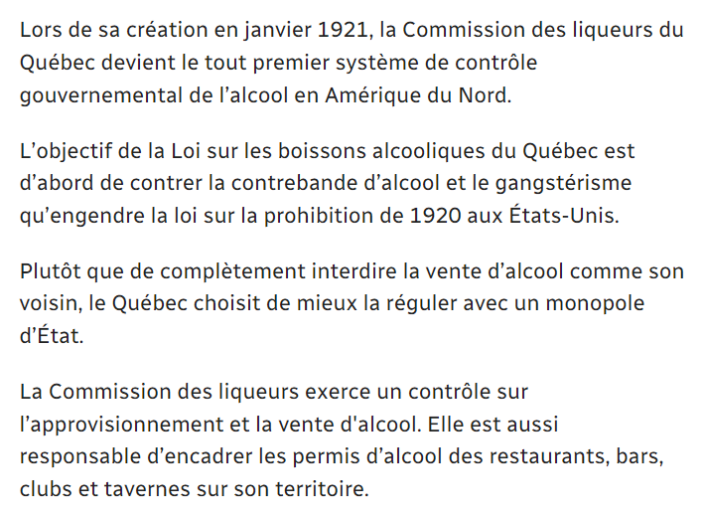
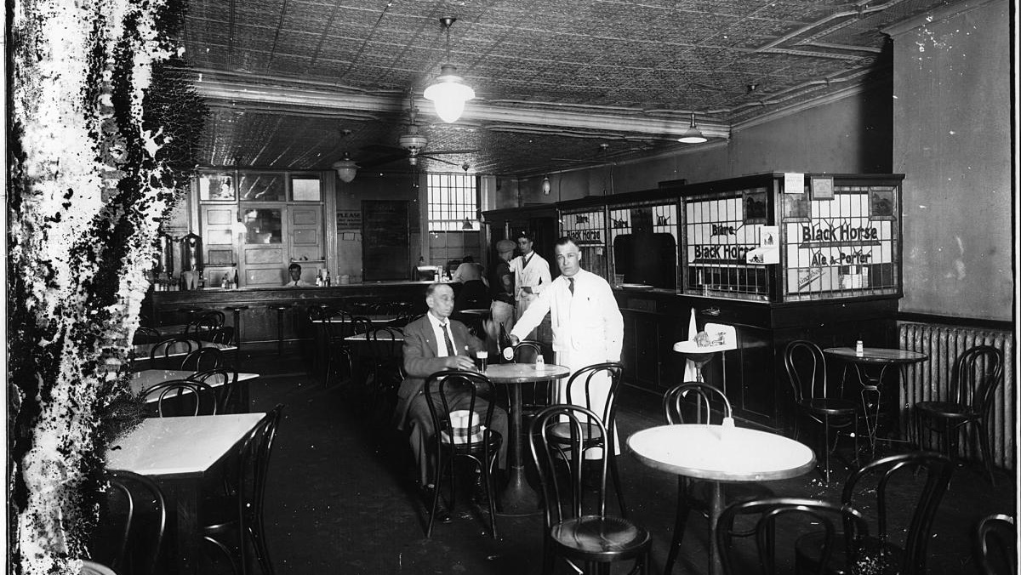
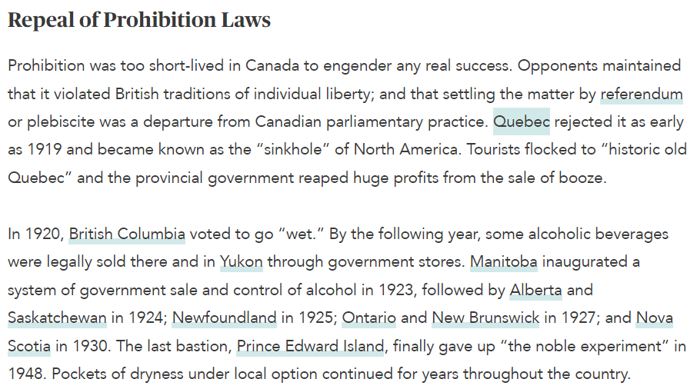
Montréal, 1921
Prohibition in Canada | The Canadian Encyclopedia
1937: Maurice Duplessis (Qc PM) bans women from entering taverns

Slide 5
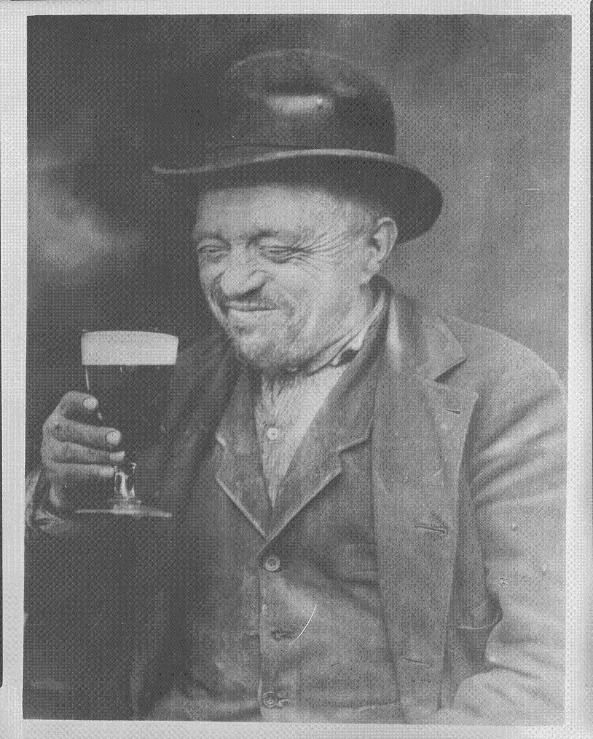
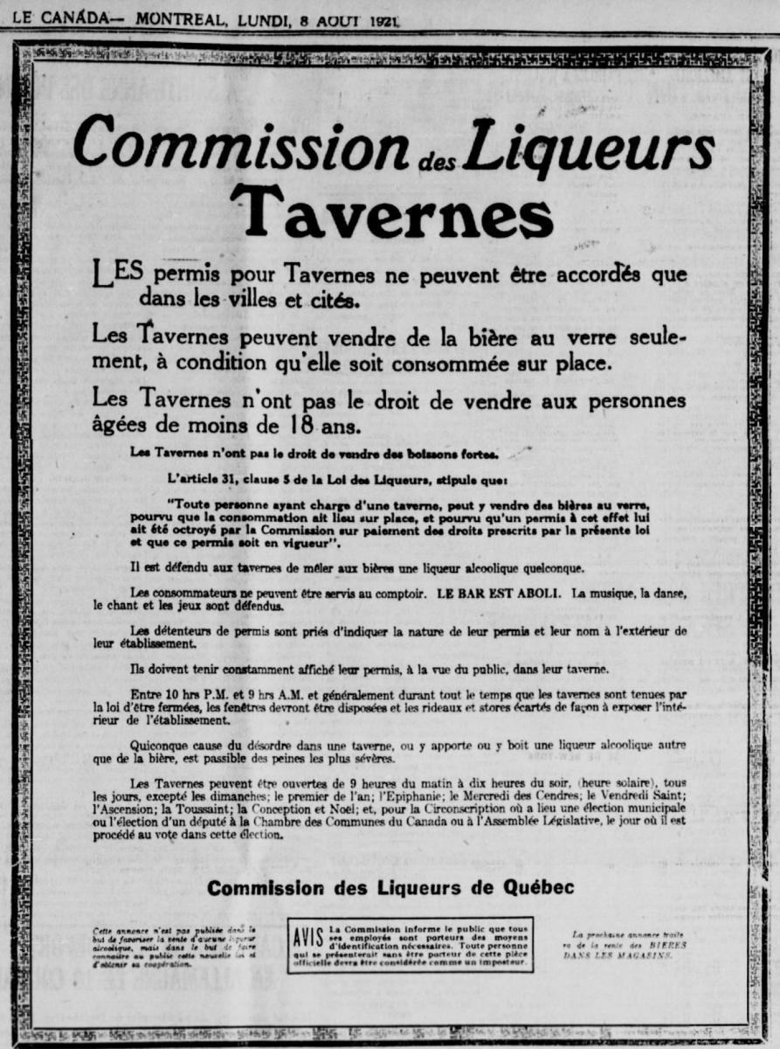

Slide 6
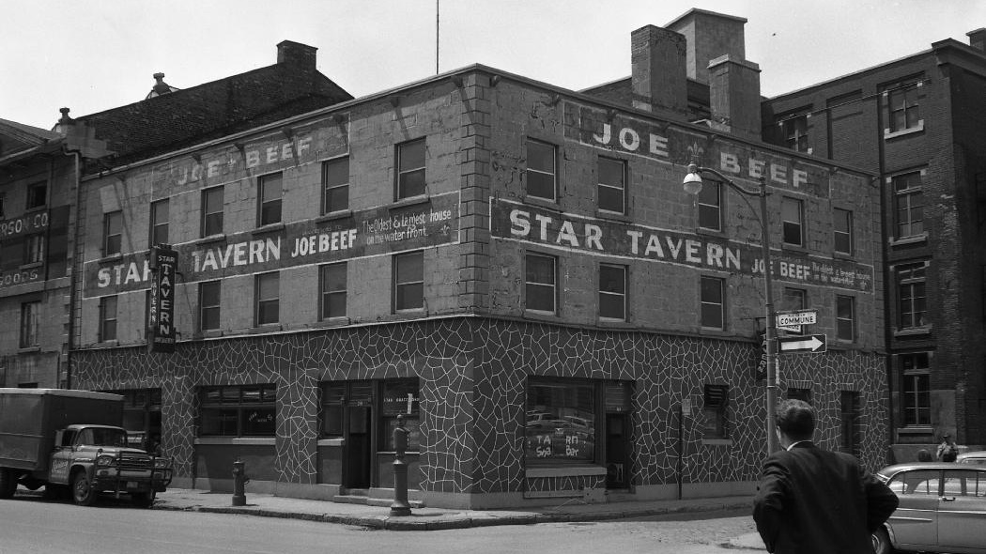
Montréal, 1964
1979: Women are now finally allowed again in taverns

Slide 7

Les Bougons, a popular series in Québec depicts stereotypical characters from the working class

Slide 8

a generic hipster in his parents’ micro-brewery (circa 2018, author’s estimation)

Slide 9
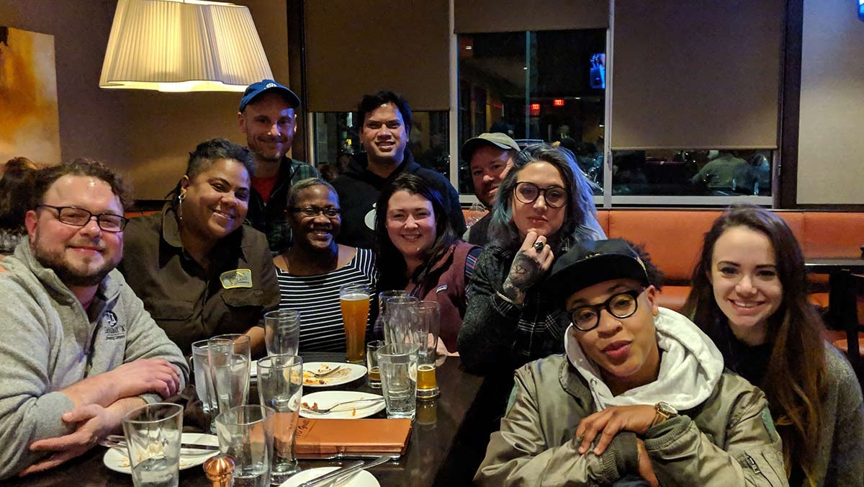
We know that nearly 80 percent of craft beer consumers in Massachusetts are white, and that there are only a handful of brewers and brewery owners of color across the state. There are beer names and artwork that objectify women, or marginalize and alienate different cultures. Instances when a Hispanic person may be the only person of color in a taproom despite the heavily populated Latino neighborhood that surrounds the brewery’s walls. Instances when a customer will ask to speak to the male bartender instead of the female for beer recommendations. Assumptions made that the man is the brewer and/or owner, and that the woman couldn’t possibly be either — let alone both. - Mass Brewers Guild

Slide 10
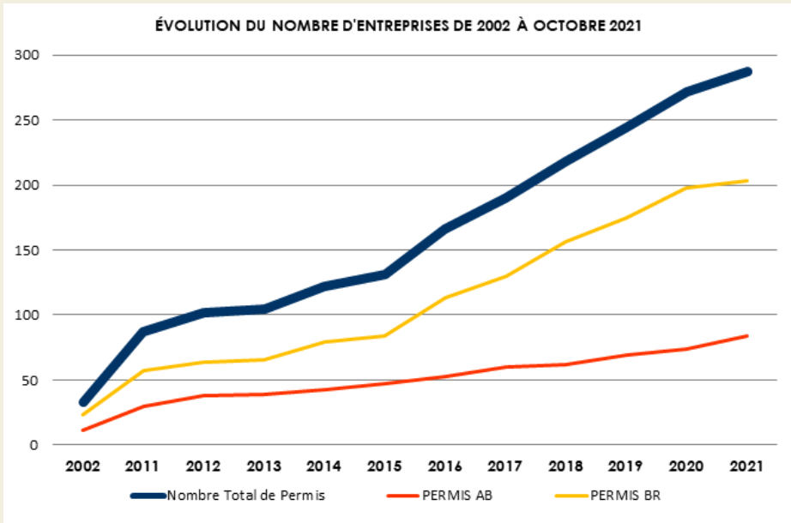
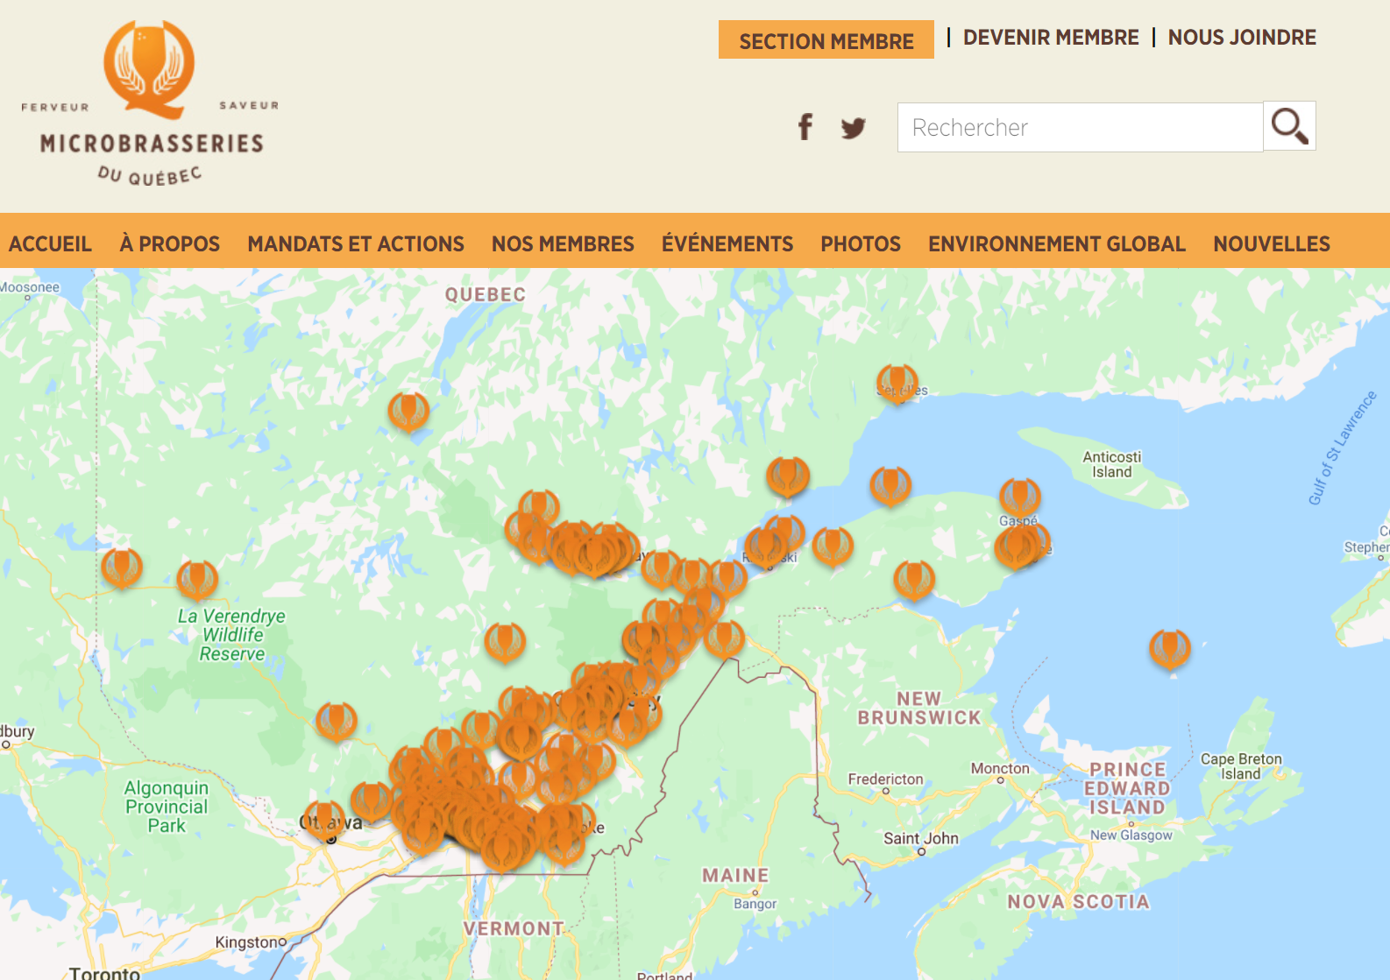
Définitions:
Permis AB: "Artisan Brasseur - Producteur artisanal de bière"
Permis BR: "Brasseur - Fabricant industriel"
Source: Association des microbrasseurs du Québec. 2021. « Portrait statistique de l’industrie brassicole au Québec ». En ligne. https://ambq.ca/mod/file/ContentDoc/bac9162b47c56fc8a4d2a519803d51b3.pdf

Slide 11
INDUSTRY OUTLOOK
$605.2B | $816.8B | 6% (2020-26) | 8% Increase
Global beer market size in 2020 | Projected worth by 2030 | Predicted CAGR (Compound Annual Growth Rate) | Number of brewing facilities, from 1120 in 2019 to 1210 in 2020 in Canada
Sources:
[1] Allied Market Research. 2021. Beer Market by Type (Lager, Ale, Stout & Porter, Malt, and Others), Packaging (Glass, Metal Can, and Others), Category (Popular-Priced, Premium and Super Premium), and Production (Macrobrewery, Microbrewery, and Craft Brewery): Global Opportunity Analysis and Industry Forecast, 2021–2030. https://www.alliedmarketresearch.com/beer-market
[2] Beer Canada. 2021. “2021 Industry Trends”. https://industry.beercanada.com/statistics

Slide 12
Part 1 – Business Context
Part 1 – Business Context
The Evolution of the Market
Some Recent Figures
The Research Question:
In light of the continued and predicted growth of the market, what qualities should breweries prioritize in their products?

Slide 13
Part 2 – Data & Models
Part 2 – Data & Models
An International Dataset from an online community
Linear Regression
Random Forest
Part 3 – Deployment & Business Impacts
Improving Breweries Decision-Making by Prioritizing the Right Elements
Providing Customer Services Through Recommander Systems
Refining Our Understanding Through Customer Segmentation

Slide 14

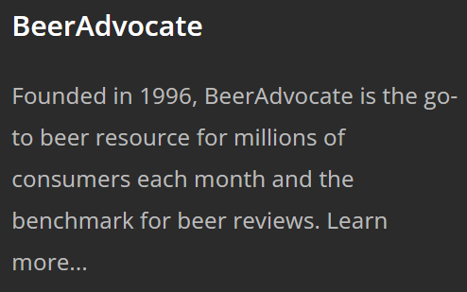
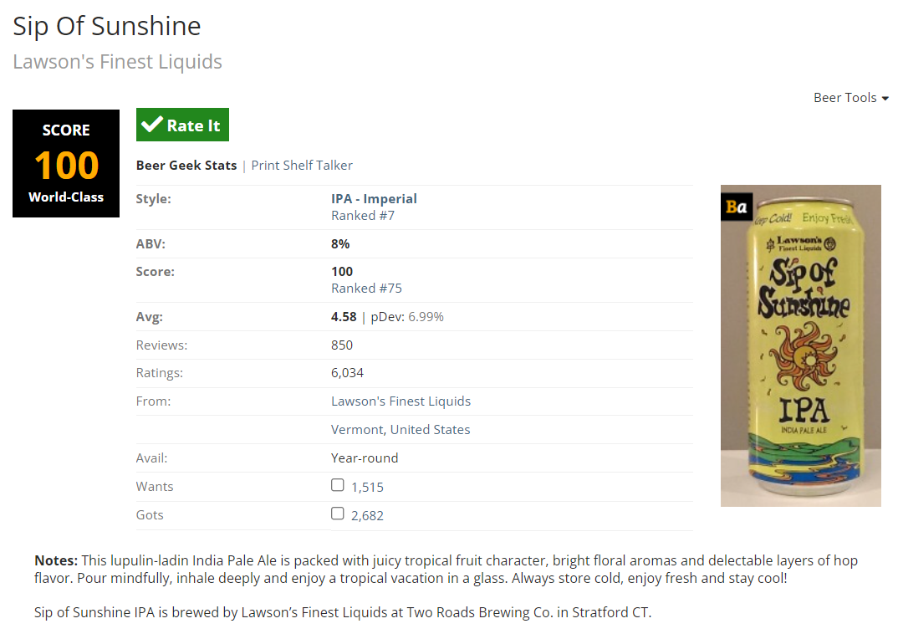
Part 2 – Data & Models
Data Source: https://www.kaggle.com/rdoume/beerreviews
Part 2 – Data & Models
An International Dataset from an online community
Linear Regression
Random Forest

Slide 15
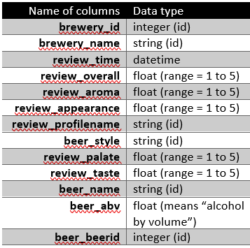
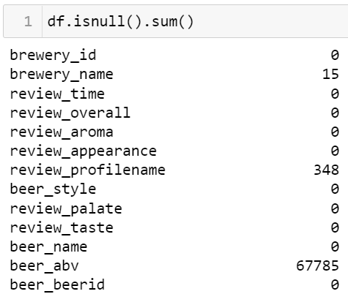
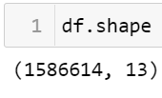
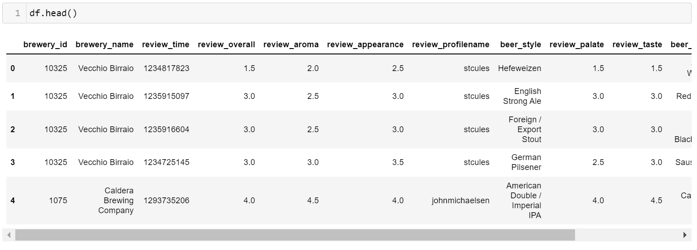
Part 2 – Data & Models
Part 2 – Data & Models
An International Dataset from an online community
Linear Regression
Random Forest
Each row = one beer review

Slide 16
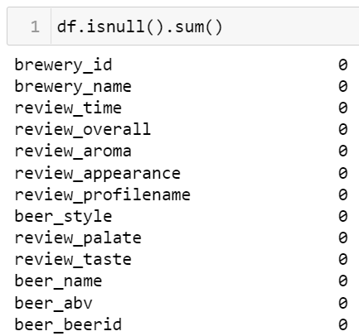
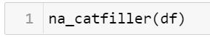

Part 2 – Data & Models
Result after dealing with missing values
Target variable-->
Part 2 – Data & Models
An International Dataset from an online community
Linear Regression
Random Forest

Slide 17
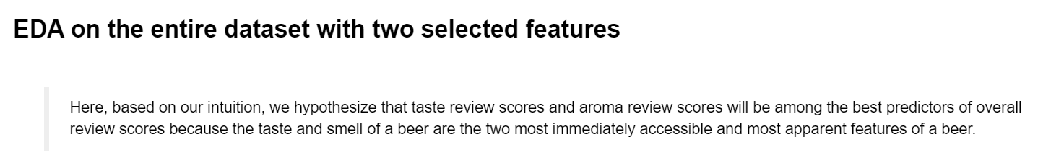
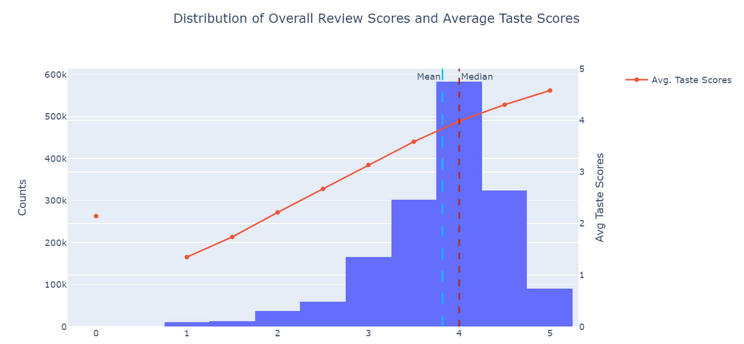
Part 2 – Data & Models

Slide 18
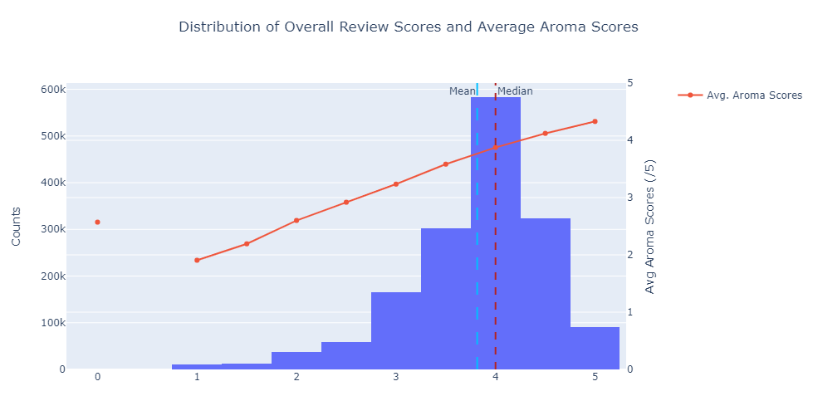
Part 2 – Data & Models

Slide 19
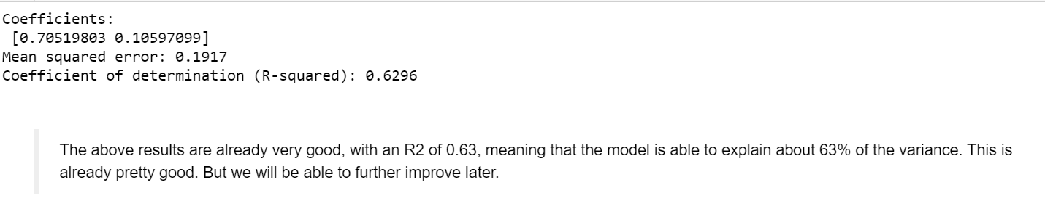
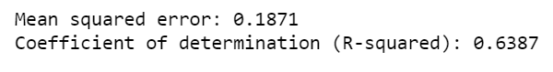
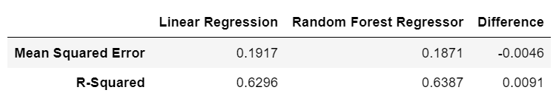
Part 2 – Data & Models
Baseline Linear Regression Model
Baseline Random Forest Regressor
Comparative Model Evaluation

Slide 20
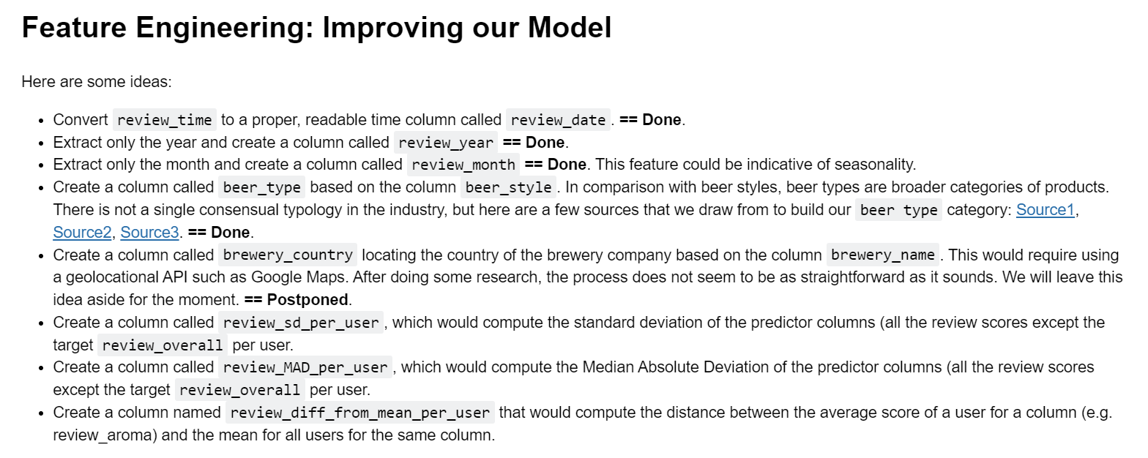
Part 2 – Data & Models

Slide 21
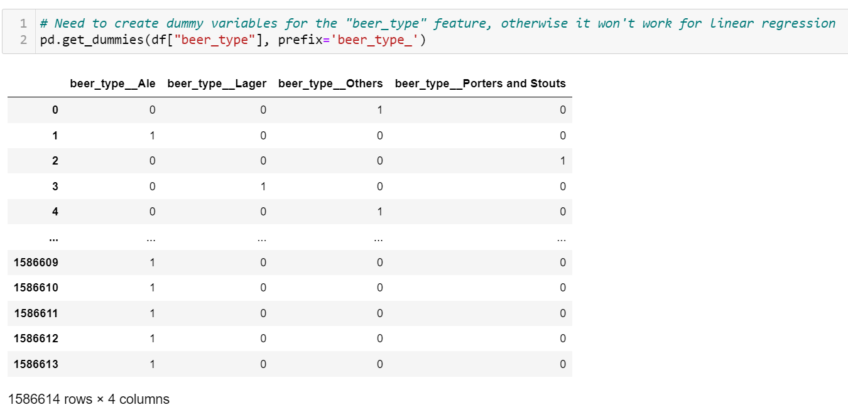
Part 2 – Data & Models
One-Hot Encoding: transforming categorical variables into 0s and 1s

Slide 22
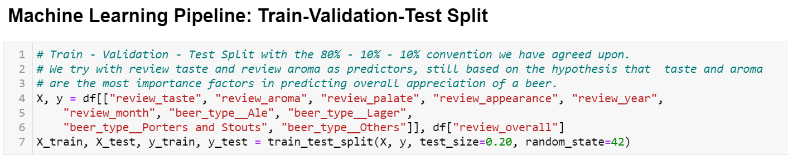
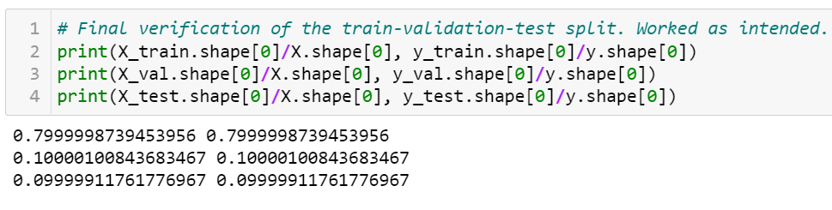
Part 2 – Data & Models

Slide 23
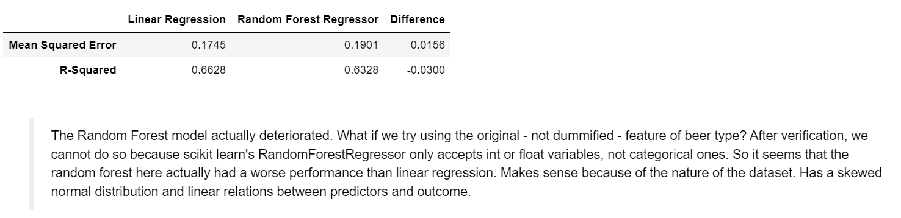
Part 2 – Data & Models

Slide 24
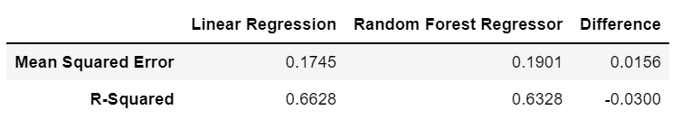
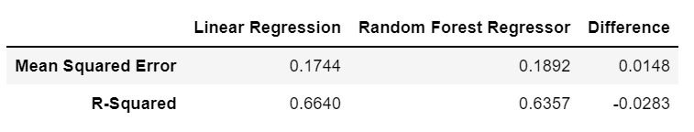
Part 2 – Data & Models
On Validation Set
On Test Set

Slide 25
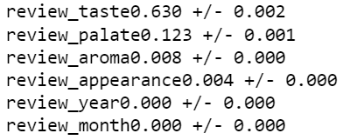
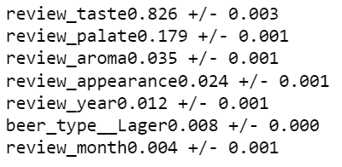
Part 2 – Data & Models: Feature Importance
Sklearn’s permutation importance: Permutation feature importance is a model inspection technique that can be used for any fitted estimator when the data is tabular.
Linear model
Random Forest Regressor
Top 5 most important features are the same, in the same order

Slide 26
Part 3 – So What? Future Directions, Deployment and Business Impact
Recommendation: Improving Breweries Decision-Making by Prioritizing the Right Elements
Limitations and Short-Term Solutions
Providing Customer Services Through Recommender Systems
Refining Our Understanding Through Customer Segmentation
Recommendation: Feature Importance → Priorities (taste > palate > aroma > appearance)
Limitations and Short-Term Solutions:
Limited number of features (country, gender, demogr.): More feature engineering (e.g. the website includes geolocational data such as the country of the brewery for each beer review)
Collect more data
Representativeness / validity of the data? Perhaps those who don’t write reviews have different opinions
Usability of the dataset: more local market studies could be conducted for practical business applications

Slide 27
Part 3 – So What? Future Directions, Deployment and Business Impact
Recommendation: Improving Breweries Decision-Making by Prioritizing the Right Elements
Limitations and Short-Term Solutions
Providing Customer Services Through Recommender Systems
Refining Our Understanding Through Customer Segmentation
Building a recommender system as a customer service (... “you might like”)
Was able to build the basic algorithm with scikit surprise
Further developing an understanding of a specific market (e.g. Québec, Canada, the U.S., Europe) as local dynamics are likely different from one region to another. Customer segmentation to target the right clientele, offer products that respond to the demand, and appeal to new customers who may not know they like beer

Slide 28
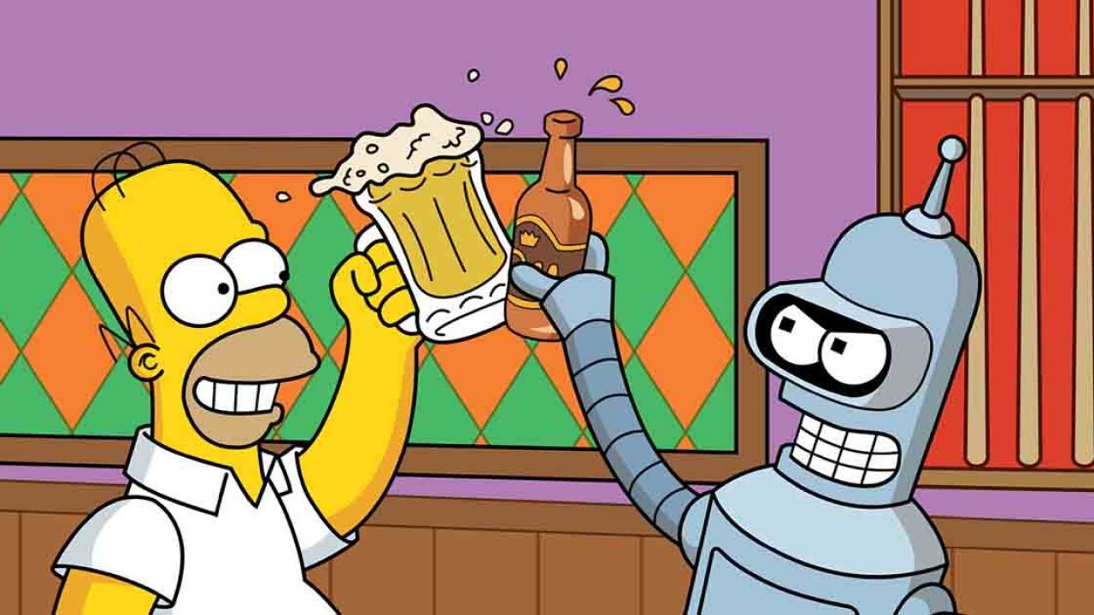
THANKS and CHEERS!
myself
sklearn

